Slide 1
The CODE WARRIOR’S Presents
System utility services
&
Hardware Interaction
Using ‘C’ Language
Presented By: Himanshu Jaswal && Prince Goyal .

Slide 2
Introduction
Our project is developed by using ‘C’ language.
In this project we are manipulating files and folders and we are playing with hardware and performing some great task that most of the people doesn't know about such ‘C’ codes.
This Project is divided into Two main parts.
Utility Services.
Hardware Interaction.

Slide 3
About utility services
This part deals with the manipulation on documents , files , folders present in local drive ‘c’.
Utility Services Contains Two Parts.
File Services.
Folder Services.

Slide 4
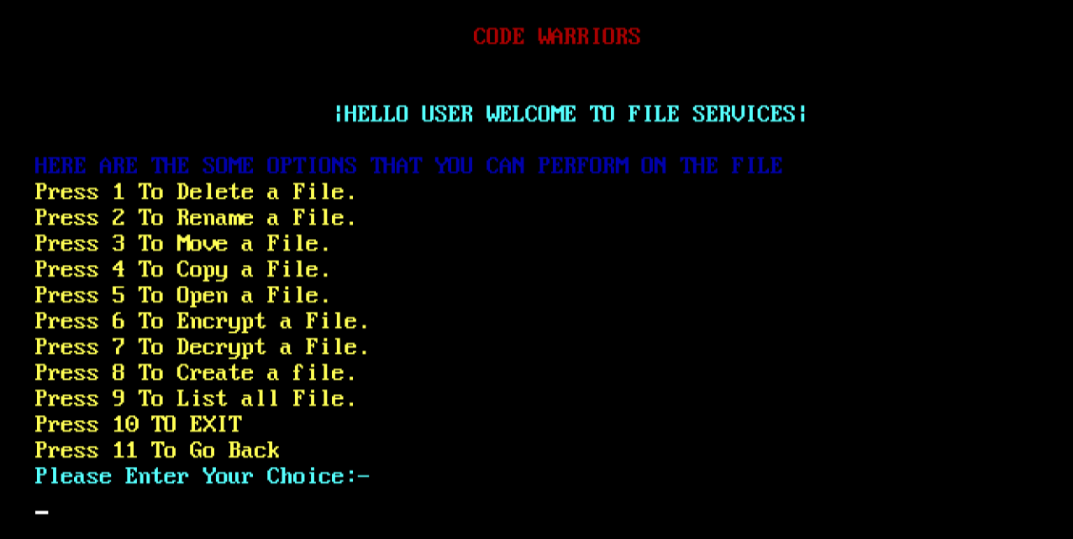
File services
With the help of file services we can perform various Operations on Files present in “local disk C”.
Create a File.
Open existing File.
Delete a File.
Rename a File.
Copy a File.
Move a File.
Encrypt a File.
Decrypt a File.
List All Files.

Slide 5
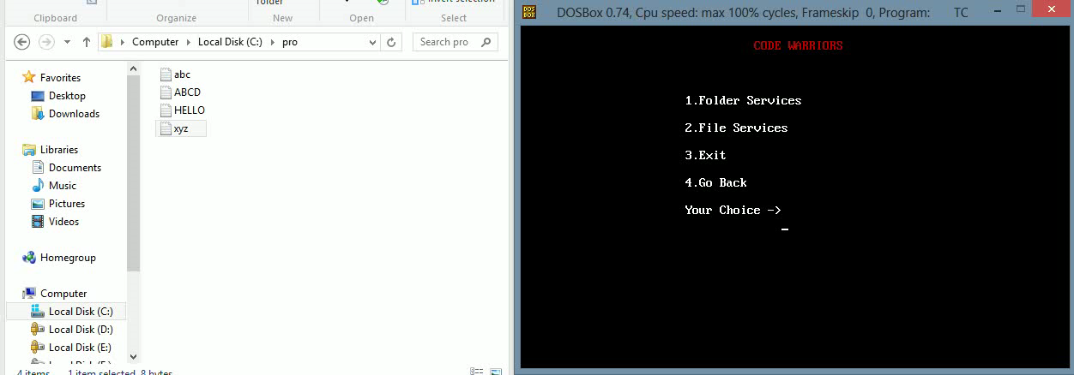

Slide 6
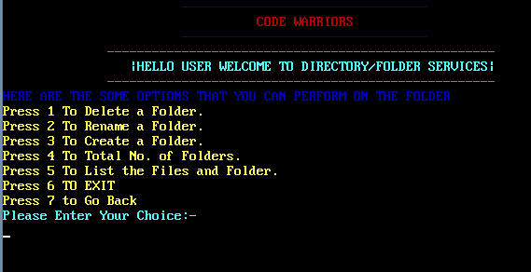
Folder services
With the help of folder services we can perform various Operations on Folders present in “local disk C”.
Create a Folder.
Delete an Created Folder.
Rename a Folder.
To Know How many number of folders are there .
List of files and folders.

Slide 7
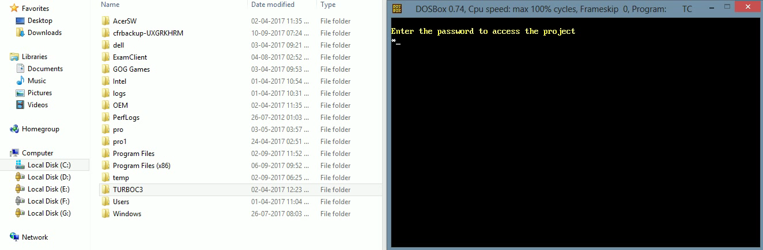

Slide 8
About hardware interaction
This part of our project is very interesting here we have written such code so that we can see and use mouse pointer on the console screen of ‘c’ compiler.
Here we performed five tasks.
Show mouse pointer on console screen.
Restrict mouse pointer to move in selected portion.
Get the values of mouse pointer position and enable left and right click.
Draw with mouse pointer on console screen.
Creating a button and getting sound by clicking on it.

Slide 9
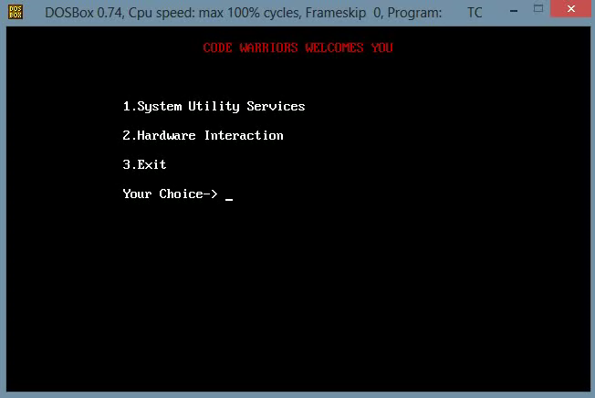
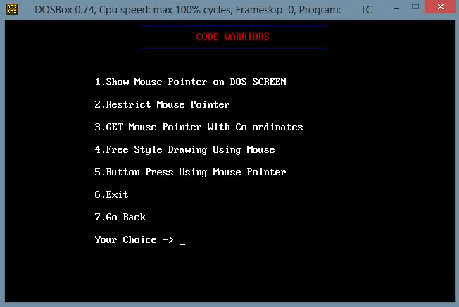

Slide 10

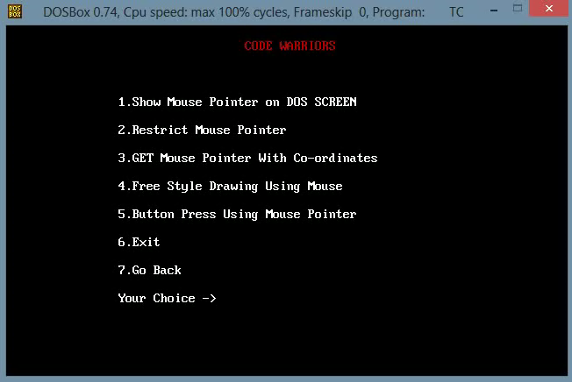

Slide 11
Key Features
More secure as it is password protected.
User friendly interface.

Slide 12
Guidelines & references
Learning ‘C’ Programming and Resister Keys from various books and websites.
Sincere implementation of any suggestion from friends and teachers.
Analysing the concept that can be used to develop proper program.
Group discussion on time to time.

Slide 13
Conclusion
Hence , conclusively there is no doubt that this project was completed with a lots of intensives ,effort and time. It allow us to partially control our system by the use of ‘c’ Programming and Registers codes.
As a whole, the project was a good learning experience for all two of us. We gained Knowledge and ideas on the various aspects of programming and register codes. Skills of genuine teamwork was one of the significant thing learnt during the project development.

Slide 14
Thank you …

